Slide 1
Innovations in borehole image data acquisition and processing
ASEg 2015
Timo korth
Advanced Logic technology sa

Slide 2
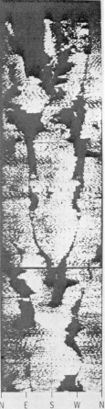
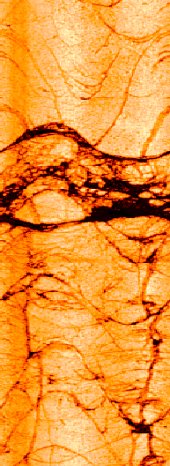
Motivation
~100 slim hole ATV / OTV tools released to the market every year
Several hundred kilometers of image logs are acquired yearly in the mining industry alone
Image logging has been fully accepted by the industry
60+ years of research and development in (ATV) image logging
1995
2015

Slide 3
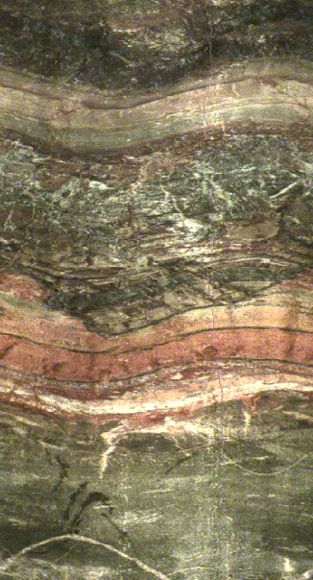
Contents
Introduction
Acoustic Televiewer ( ATV) and Optical Televiewer (OTV) tools today?
What is the latest in data processing software?
Conclusion

Slide 4
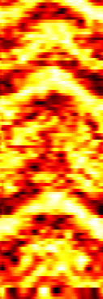
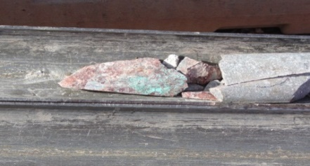
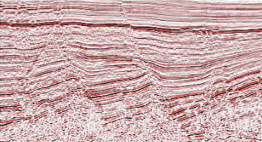
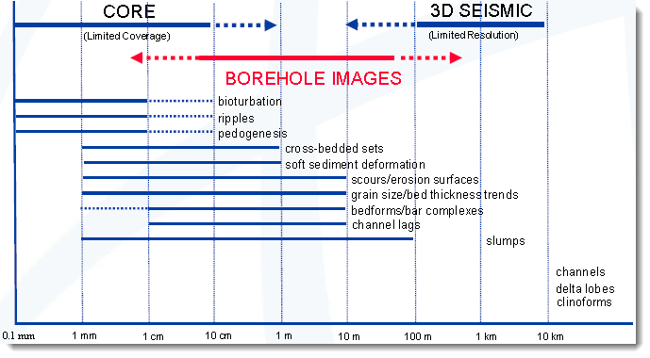
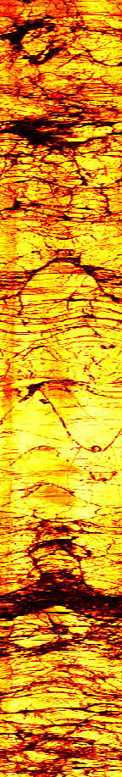

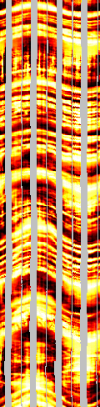
Introduction (cont.)
Radioactive
Ultrasonic
Optical
Electrical
Where does Image Logging fit in?
Limited
Coverage
Orientation?
Limite
Limited
Resolution

Slide 5
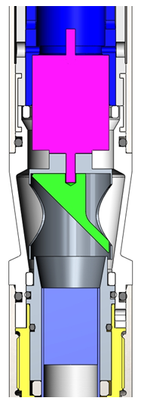
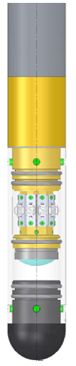
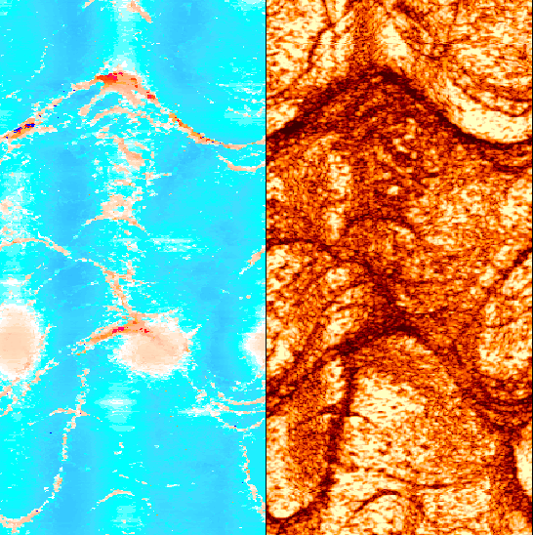
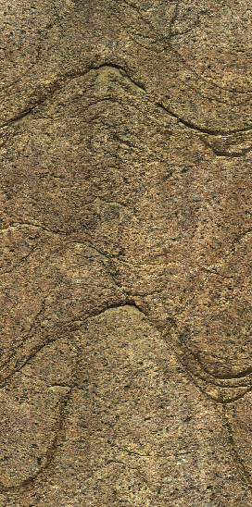
Introduction (cont.)
Latest in Acoustic (ATV) & Optical Televiewer (OTV) Technology
Motor
Focusing Mirror
LED Light
CMOS Sensor
Transducer
Lens
Travel Time
Reflected Amplitude
True Color Image

Slide 6
ATV - Tools & Benchmarks
 | ATV 9804 (Century) | USS (Raax) | HRAT (RG) | ABI 42 (Electromind) | ABI 40-2G, 43, 85 (ALT sa)
Diameter [mm] Length [m] Weight [kg] | 50.8 2.25 14 | 50 0.93 - | 42 1.62 - | 42 2.1 10 | 40, 43, 85 (92) 1.61, 1.7, 5.2 6.7, 10, 150
Max. Temp [°C] Max. P [bar] | 85 105 | 50 50 | - - | 70 150 | 70, 125 (175), 300 200, 800, 700 (1400)
Circ. Res. [pts] Vert. Res. [mm] | 256 5 | - - | 360 (var.) - | 360 (var.) - | 360 (var.) 1.5
Transducer Freq. [MHz] | - | 1.0 | 1.5 | 1.5 | 1.2
Sensor Rotation Rate per sec. | 12 | - | 20 | 20 | 35
Max. Op. Diam. [mm] | 230 | 148 | 380 | - | 600
Orientation | Magnetic, G | Mech. Compass | Magnetic, G | Magnetic, G | Magnetic, G
Stackable | +GR | No | + GR | + GR | Yes (40, 43)
Logging Speed [m/min] | 3 | 0.6 | 2.5 @ 180 pts, 3mm | 2.5 @ 180 pts, 3mm | 6-7 @ 144 pts, 3mm

Slide 7
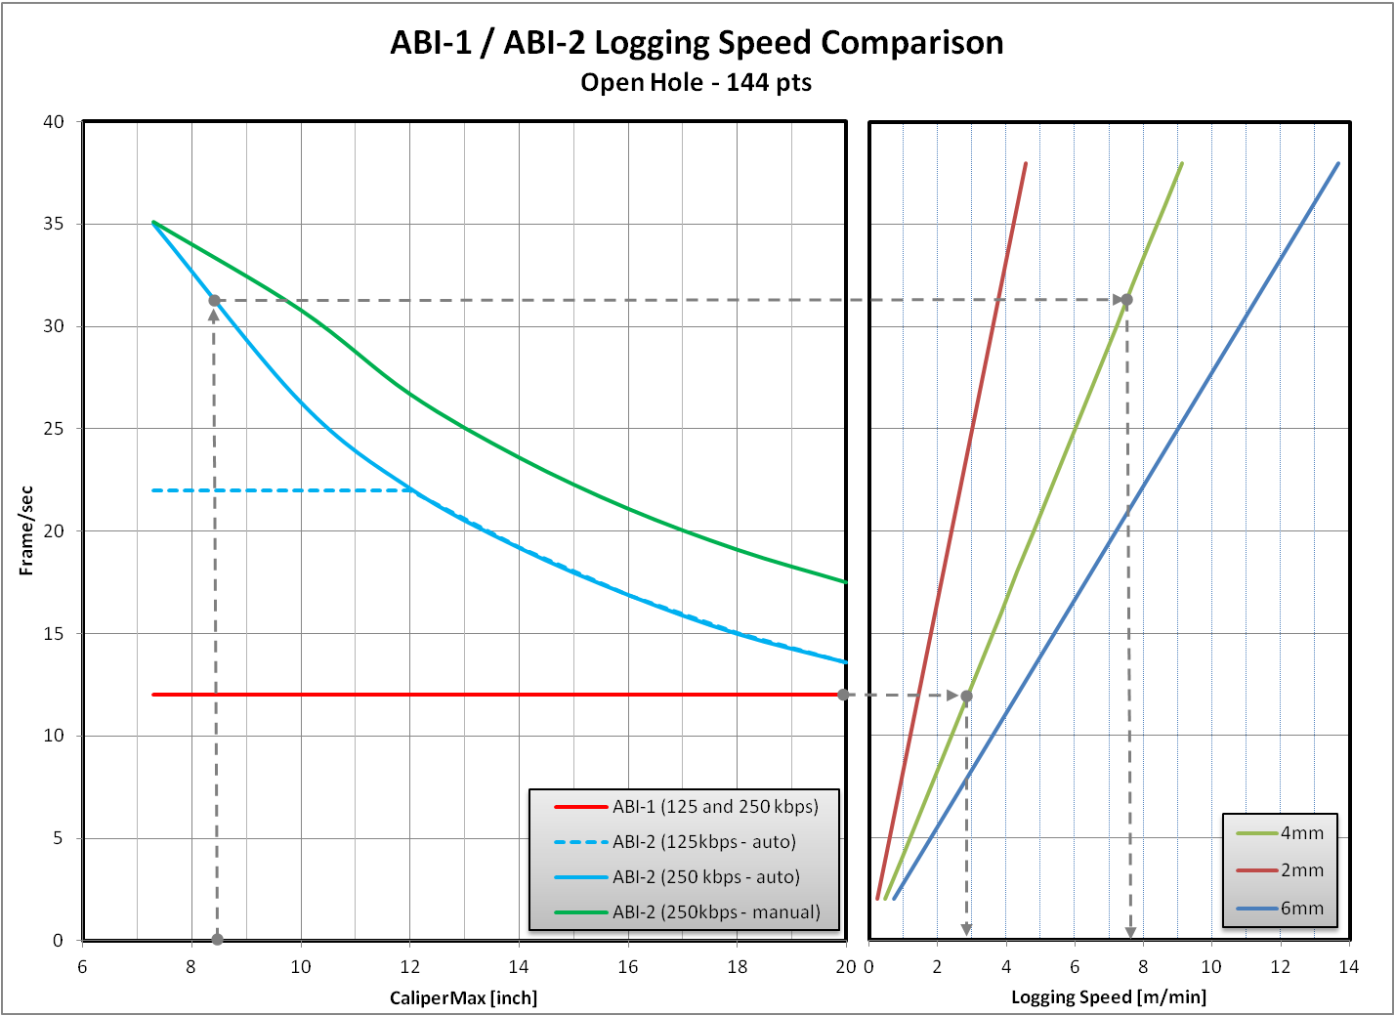
Overcoming the Bottleneck
4 m/min @ 2mm, 144 pts
32 rev/sec
man. gate
auto gate
7 m/min @ 4mm, 144 pts
12 rev/sec
Natural limit to logging speed imposed by signal travel time through fluid.
Solution: Acquire other data in the same run using stackable logging tools.

Slide 8
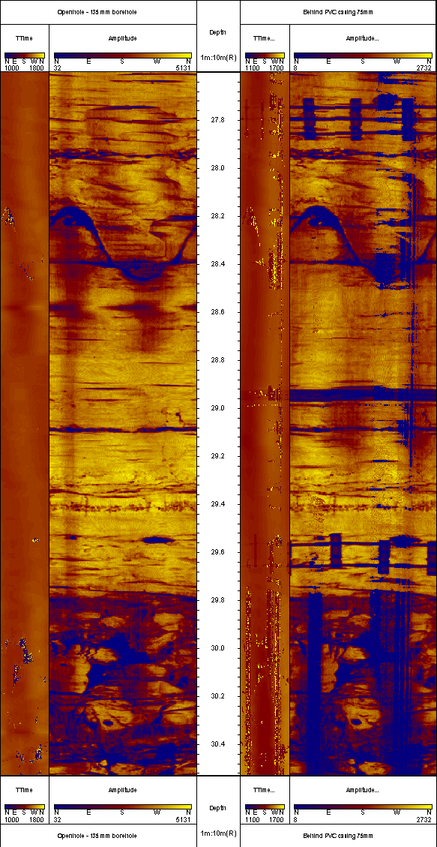
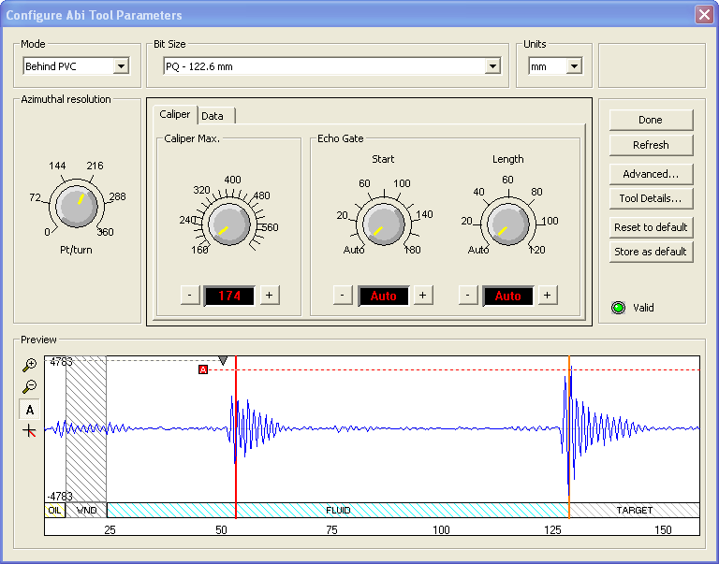
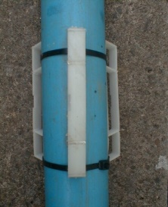
Innovation Hidden in Details
Sophisticated digital signal processing (downhole) allows
Signal cleaning (e.g. tool window reflection filter)
Signal separation (e.g. multiple echo detection)

Slide 9
OTV - Tools & Benchmarks
 | ODS (Raax) | Hi-OPTV (RG) | OBI 52 (Electromind, Geovista) | OBI 40 - 2G (ALT sa)
Diameter [mm] Length [m] Weight [kg] | 50 1.03 - | 52 1.63 - | 52 1.63 5 | 40 1.47 5.3
Max. Temp [°C] Max. P [bar] | 40 - | 60 100 (200) | 60 100 (200) | 70 200
Circ. Res. [pts] Vert. Res. [mm] | 720 0.25 | 1440(var.) Limited by depth encoder | 1440(var.) Limited by depth encoder | 1800 (var.) Limited by depth encoder
Sensor | Camera | 24 bit CMOS | 24 bit CMOS | 24 bit CMOS
Max. Op. Diam. [mm] | 200 | 300 | 300 | 530
Orientation | Mech. Compass | Magnetic, G | Magnetic, G | Magnetic, G
Stackable | No | + GR | +GR | Yes

Slide 10
Resolution
 | CORE SCAN [pixels/mm] | pixels/mm @ 900 pixels | pixels/mm @ 1440 pixels | pixels/mm @ 1800 pixels
NQ (75.7 mm) | 5 – 40 (360) 5 – 10 (Box) | 4 | 6 | 8
HQ (96 mm) |  | 3 | 5 | 6
PQ (122.6 mm) |  | 2 | ~4 | 4
Logging Speed [m/min] | ~ 3 | 6 @ 2 mm | ~2.5 @ 1 mm | ~1.5 @ 1 mm
International Grain Size Classification (ISO 14688-1)
Name | Size range (mm)
Large boulder | >630
Boulder | 200 – 630
Cobble | 63 – 200
Coarse gravel | 20 – 63
Medium gravel | 6.3 – 20
Fine gravel | 2.0 - 6.3
Coarse sand | 0.63 - 2.0
Medium sand | 0.2 - 0.63
Fine sand | 0.063 - 0.2
Coarse silt | 0.02 - 0.063
Medium silt | 0.0063 - 0.02
Fine silt | 0.002 - 0.0063
Clay | ≤0.002

Slide 11
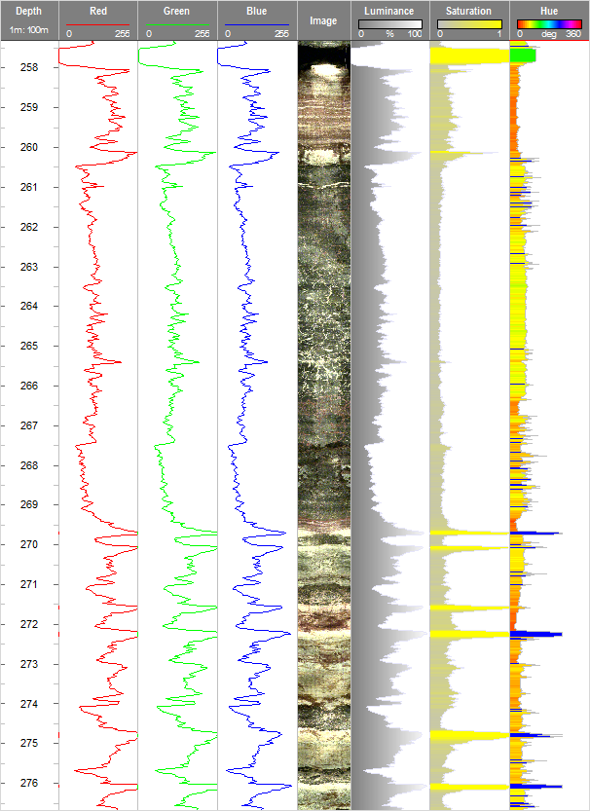
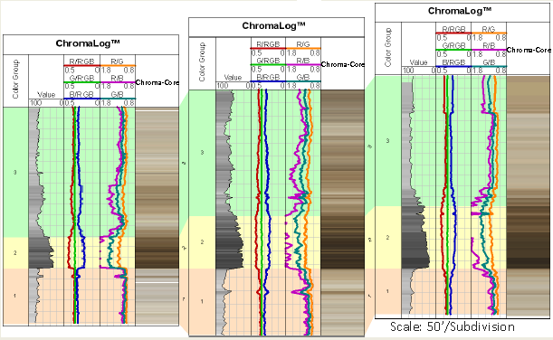
Data Processing Software - Trends
Colorimetry
Extract chromatic data like Red, Green, Blue, Luminance, Saturation and Hue
Integration of chromatic changes with stratigraphic, geochemical, wire-line or other geologic data
OTV
Luminance
Hue

Slide 12
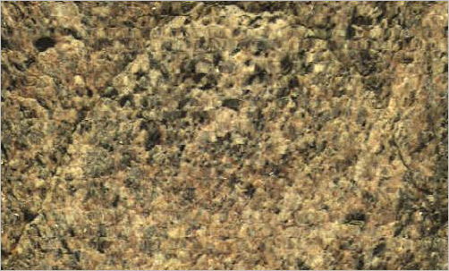
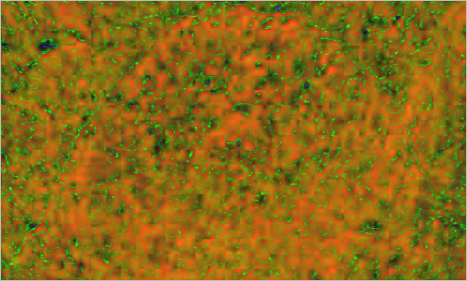
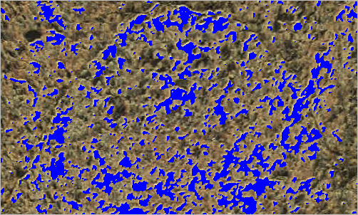
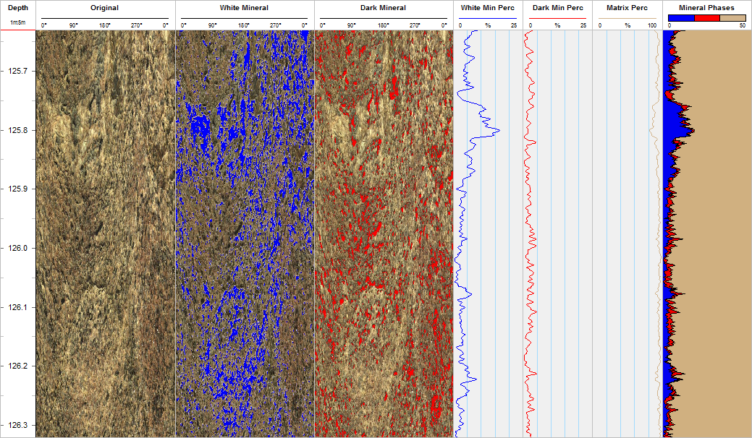
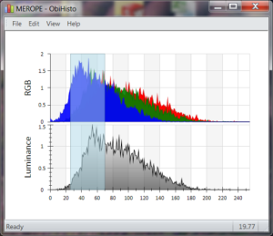
Data Processing Software – Trends (Cont.)
Colorimetry
Separation of Mineral Phases
Grain size distribution
Porosity

Slide 13
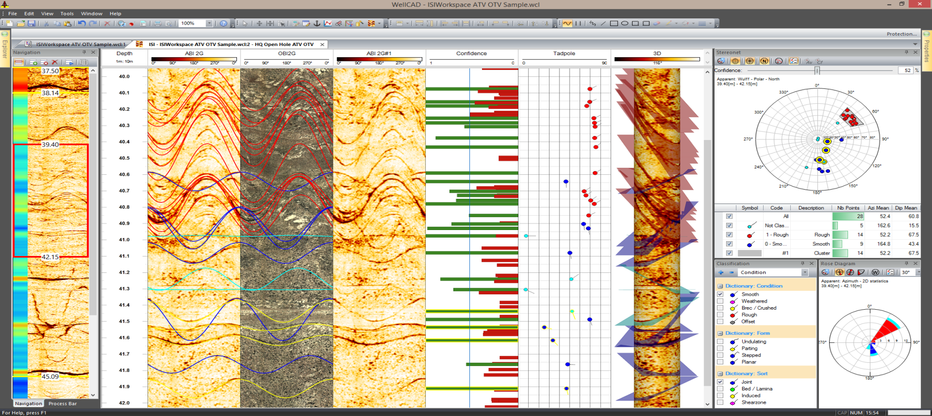
Data Processing Software – Trends (Cont.)
Task optimized workspaces
Guidance & Objectivity
Structure Workload
Manual and Auto Picking
Corrected Dips, Representative Dips
Interpretation,
Classification

Slide 14
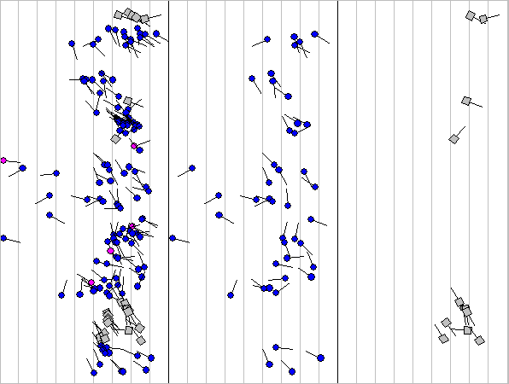
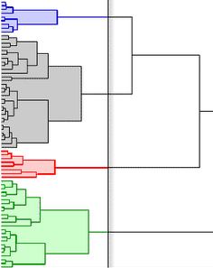
Data Processing Software – Trends (Cont.)
Representative Pick Determination
Before Clustering
After Clustering of “Blue” and “Grey”
Clustering based on Depth, Dip, Azimuth and Confidence

Slide 15
Conclusion
Motivation
Changes in user profile towards “App User” !?
User to be driven by innovation?
User to drive innovation?
Invitation to provide feedback and play a role in future innovations.

Slide 16
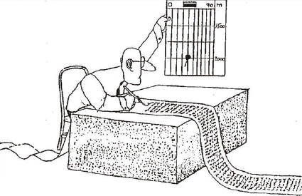
Questions ?

